Slide 1

Biostatistics
Lecture 1: Why R

Slide 2

Why R
SPSS and other non-coding programs ok but are overall more restricted
V
Allows almost any type of statistical analysis
Code allows for highly repeatable analysis
Open source (free and owned by the community)
Analysis confined to program setting
Repeating analysis can be difficult
Closed and run by private company

Slide 3
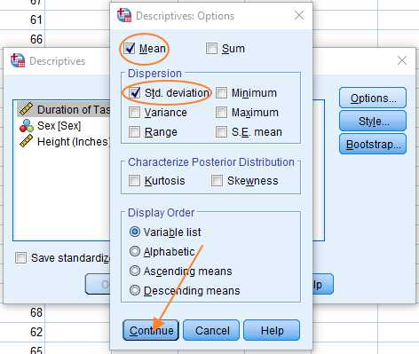
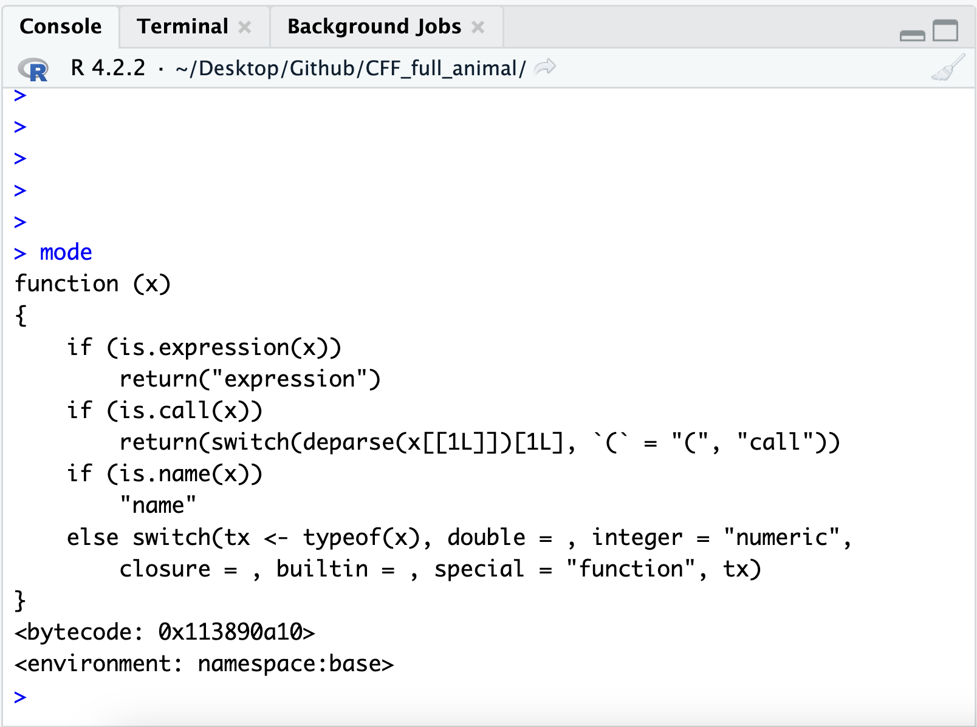
Why R
V
SPSS and other non-coding programs restricted to what buttons are available
In R and coding based programs we can create what analysis we want

Slide 4
Why R
R is a coding based programme. Instead of pressing a button, like in SPSS, you talk to programme in its language.
This means you can ask it to doe far more complex and varied things
In SPSS if the button does not exist you cannot do it. In R if the button does not exist you can ask R to make you one.
Allows almost any type of statistical analysis
Code allows for highly repeatable analysis
Open source (free and owned by the community)

Slide 5
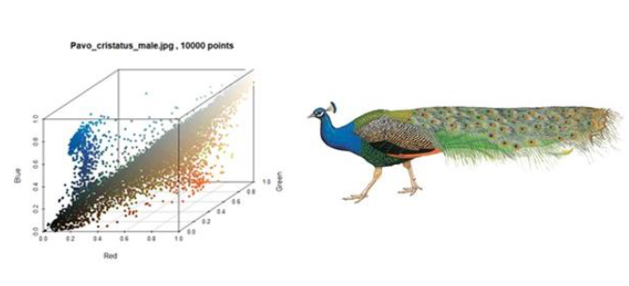
Flexibility of R
We use R in my lab for projects such as analysis animal coloration and running statistical analysis
In this case is reproductive output associated with patterns of coloration

Slide 6
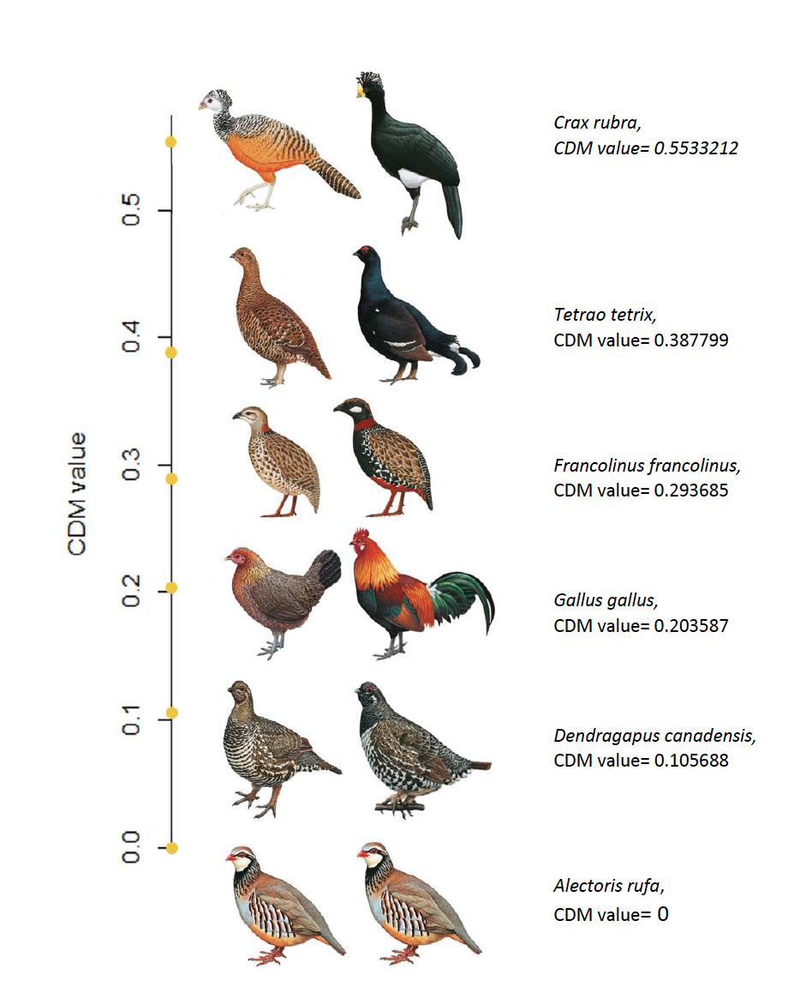
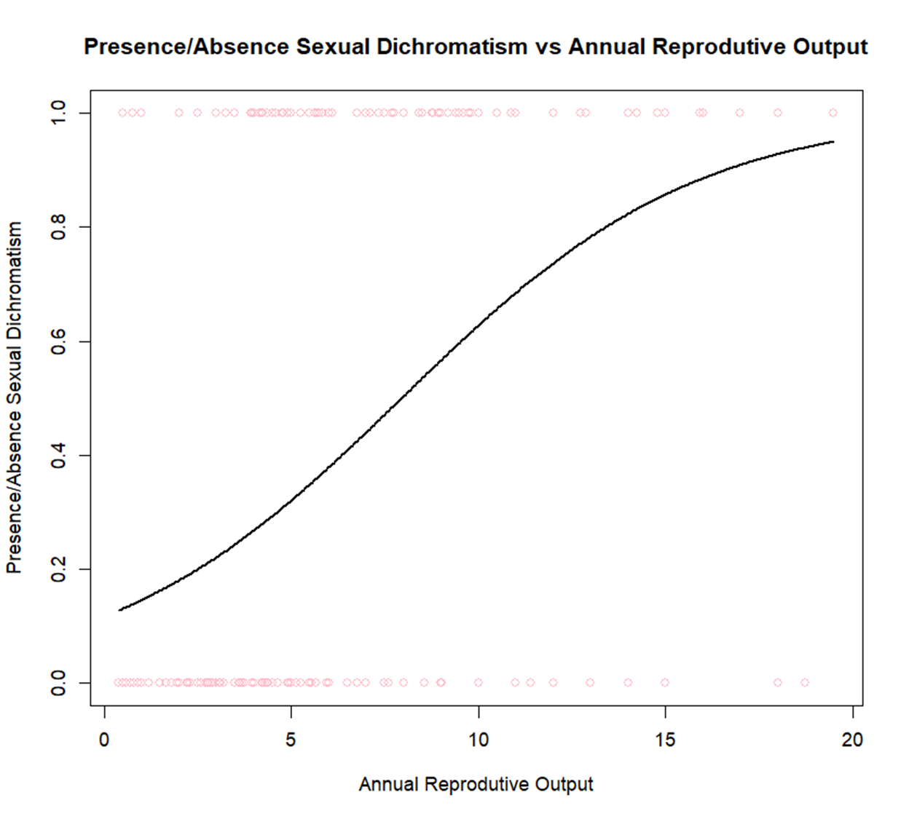
Flexibility of R
We use R in my lab for projects such as analysis animal coloration and running statistical analysis
In this case is reproductive output associated with patterns of coloration

Slide 7
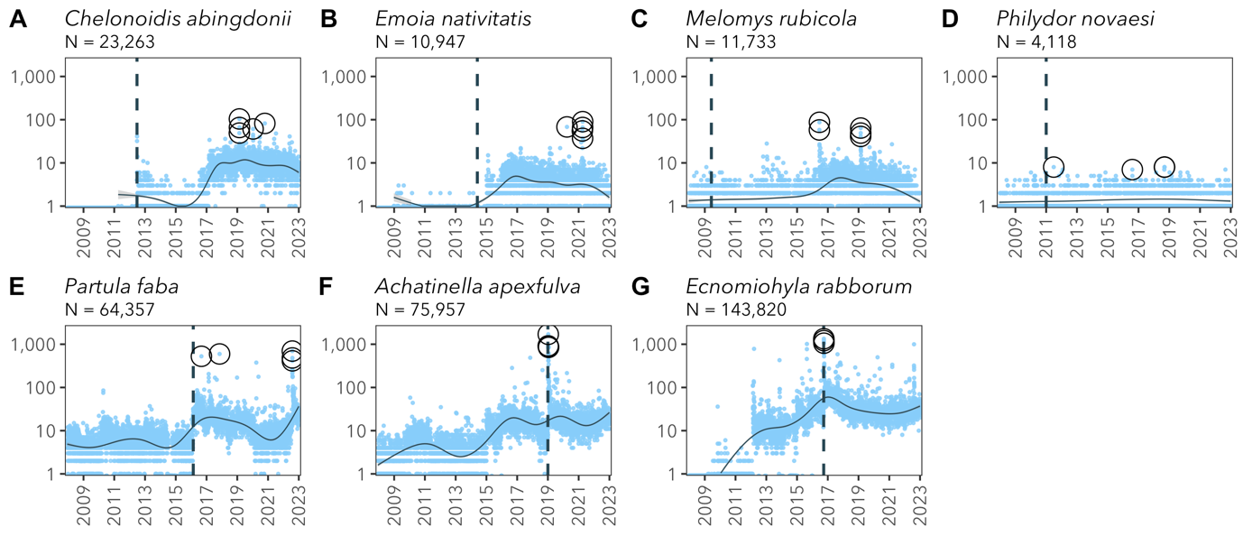
Flexibility of R
We can interface R with lots of other programs
For example, using it to look at user trends in Wikipedia and twitter

Slide 8
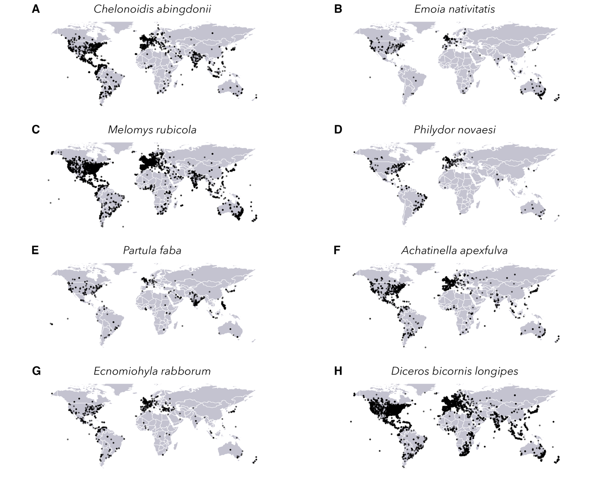
Flexibility of R
We can interface R with lots of other programs
For example, using it to look at user trends in Wikipedia and twitter

Slide 9
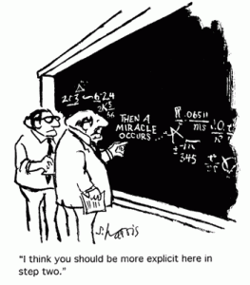
Why R
Replication is important to any claim in science – this is why we write methods sections.
Allows almost any type of statistical analysis
Code allows for highly repeatable analysis
Open source (free and owned by the community)

Slide 10
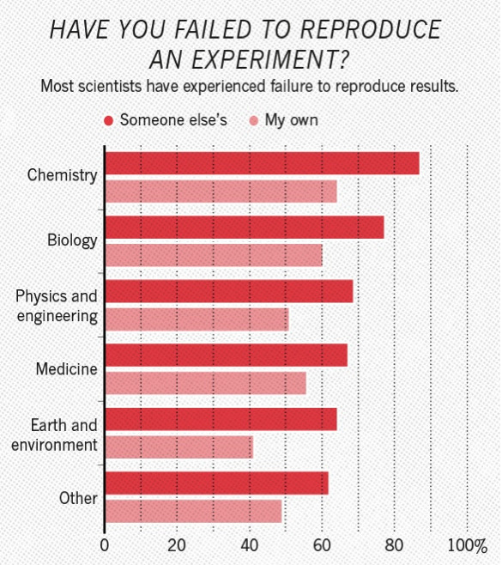
Why R
But most researchers have reported that they failed to reproduced results
Allows almost any type of statistical analysis
Code allows for highly repeatable analysis
Open source (free and owned by the community)

Slide 11
Why R
Coding based programmes allow you to give the full script of how you did your analysis.
The script allows to run someone else's analysis and get the same answer.
*This is something you will all need to achieve by the end of this module
Allows almost any type of statistical analysis
Code allows for highly repeatable analysis
Open source (free and owned by the community)

Slide 12
Reproducibility is not just R
Assignment 1: create a data management plan for your thesis project
For your thesis project think of how you could make it more reproducible. How will you store the data, what type of program you will use for analysis etc. Help files are available on CANVAS

Slide 13
Why R
All of the code that makes up R is open for all to use.
This not only means it free but also that the research community can add
there own code which can perform specific tasks (called packages)
There is also lots of help for R online
-google is your friend when learning R
Allows almost any type of statistical analysis
Code allows for highly repeatable analysis
Open source (free and owned by the community)

Slide 14
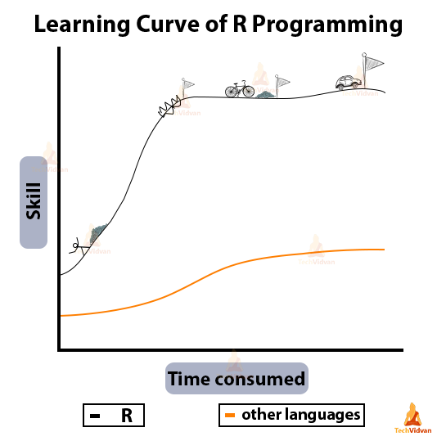
There is a steep learning curve but you will get the hang of it so stick with it

Slide 15
Lets open R for the first time

Slide 16
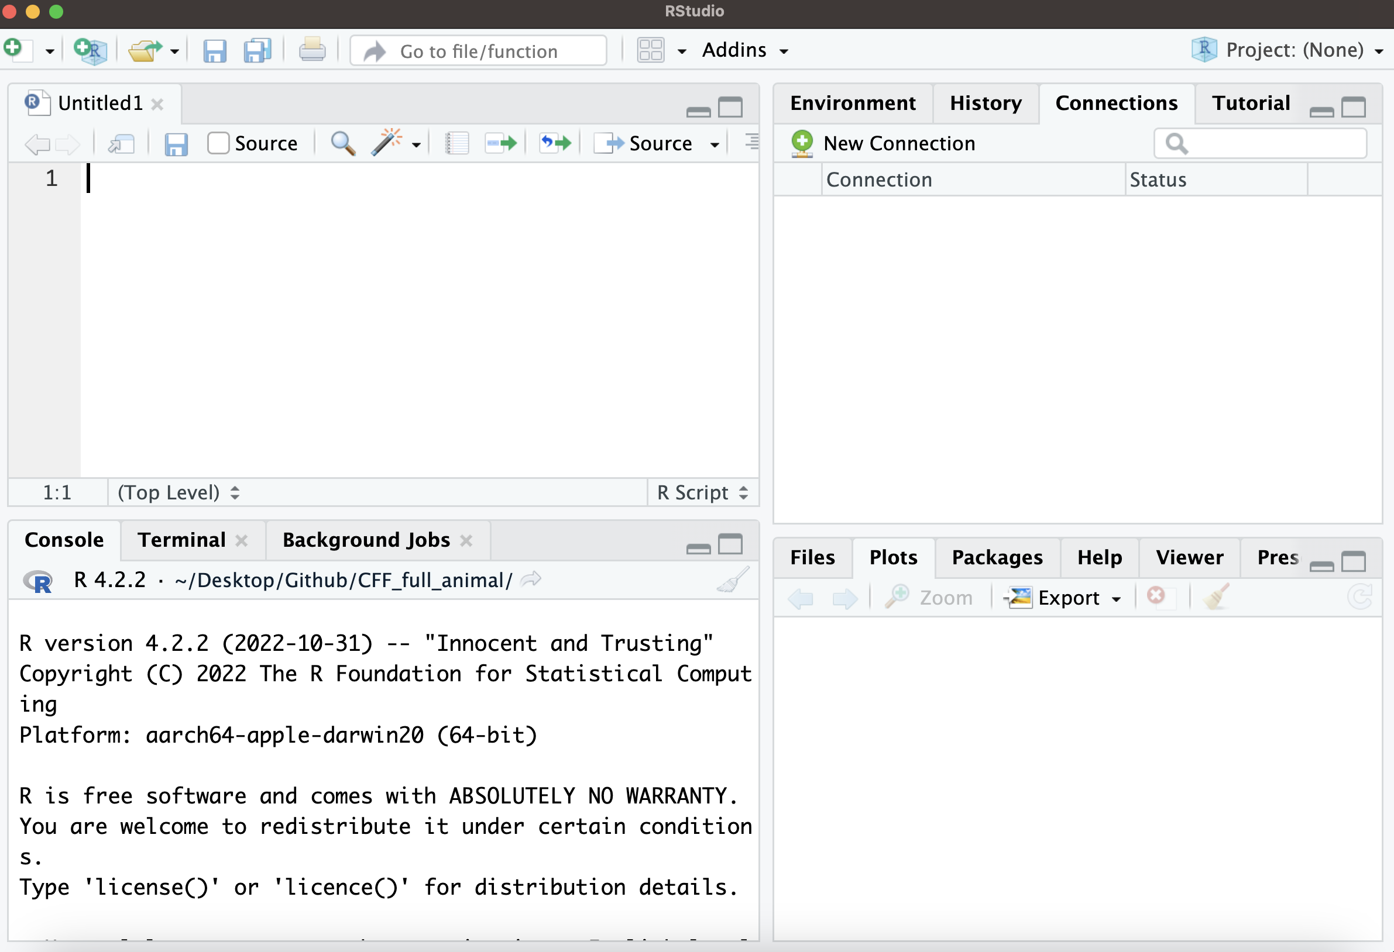
The layout of R studio
When you open R studio
you should get a window like this broken down into 4 parts

Slide 17
The layout of R studio
The top left is called the script. This is where you write code that can be saved just like a plain txt file

Slide 18
The layout of R studio
The top right is the environment. This tells you what objects you have saved in this session.
More on this later

Slide 19
The layout of R studio
The bottom right window will display help files and plots

Slide 20
The layout of R studio
The bottom left is called the consol. This is R itself.
You will be inputting and running code here.

Slide 21
The layout of R studio
The bottom left is called the consol. This is R itself.
You will be inputting and running code here.
Current version of R
R will update every 6-12 months

Slide 22
Using the console
Type commands at the cursor
Then press enter and R will execute the command and give the results in the next line

Slide 23
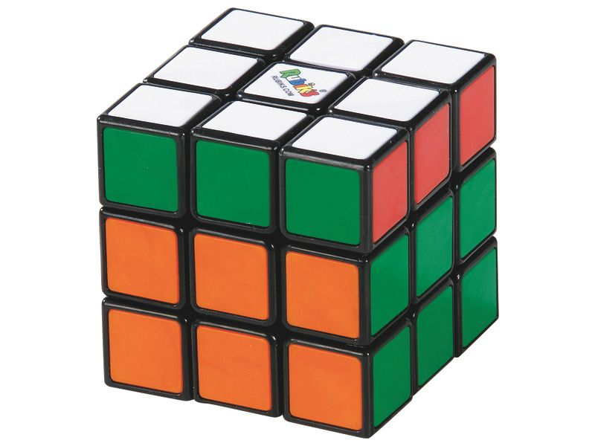
Objects in R
R allows you to save the results of commands as objects

Slide 24
Objects in R
R allows you to save the results of commands as objects
When you save an object it will now be stored in the R environment
To the left of
<-
is the objects name
This name must be all 1 word with no gaps
To the right of
<-
is the command/data you want to save

Slide 25
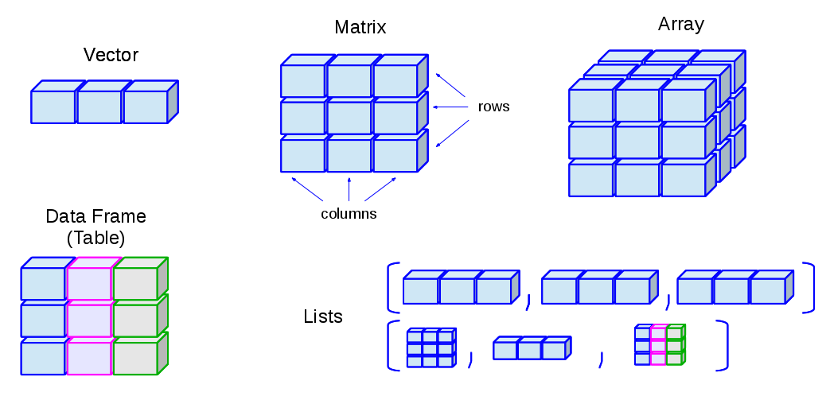
Objects in R
Objects can have different class types which arrange data in different ways

Slide 26
Objects in R
Objects can have different class types which arrange data in different ways
Vector
A simple sequence of data

Slide 27
Objects in R
Objects can have different class types which arrange data in different ways
Matrix
Data is arranged in rows and columns, typically used for mathematical computations.

Slide 28
Objects in R
Objects can have different class types which arrange data in different ways
Array
An 3 dimensional version of a matrix
Like a stack of matrices

Slide 29
Objects in R
Objects can have different class types which arrange data in different ways
Data frame
Data is organized in rows and column but we now name the columns. Different from a matrix in that it works more like how a data sheet (think excel)

Slide 30
Objects in R
Objects can have different class types which arrange data in different ways
Lists
An object that can contain a mix of vectors, matrices and data frames

Slide 31
Objects in R
Objects can have different class types
You will mostly be working vectors and data frames

Slide 32
Objects in R
Objects can have different class types
A simple sequence of input
For example, 1, 2, 3, 4 is a sequence of 4 numbers
We can write this in R as
c(1, 2, 3, 4)
The letter c tells R to write a vector, the brackets () tell R were the start and end of the vector is and the commas , tell R that each number is a new entry in the vector

Slide 33
Objects in R
Objects can have different class types
Task
Create the vector 10, 5, 1, 100
And save it as an object called new_vector

Slide 34
Vector_1
Vector_2
Vector_3
1
3
4
2
4
55
Data frames store data in rows and columns, Each column is typically a vector.
3
60
0
Each vector is a column
1
3
4
Each entry from the
Vectors is now in a row
2
4
55
3
60
0

Slide 35
Data frames store data in rows and columns, Each column is typically a vector.
We can write a basic data frame with 2 vectors such as
new_data <- data.frame(col_1 = c(1,2,3,4),
col_2 = c(10,5,4,11))
data.frame is a function that tells R to create a data frame, the brackets () tell R were stop and start the data.frame and then we can write 2 vectors using c() like before. We can also name the columns as “col_1” and “col_2”

Slide 36
Data frames store data in rows and columns,
We can also ask R to tell us what entries are in different positions in the data frame using square brackets [ , ] were the first entry asks for the rwo and the part after the comma asks for the column.
For example, to get the entry from the first row and the second column we type in
new_data[1,2]

Slide 37
Atomic types/classes
Numeric: Real number, i.e. 1,, 2, 0 , -100, 0.34 etc.
(complex numbers are a different atomic type but we wont cover that here)
Character: “words”
We use the “” to tell R something is a character and not something like the name of a vector
Logic: TRUE or FALSE
These are important for building arguments in R which we will see later

Slide 38
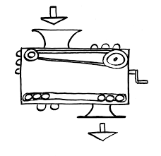
Functions
Input (data)
function
output (results)

Slide 39
Functions
c(20, 10, 15)
mean()
15

Slide 40
Functions
The bottom right window will display help files and plots
Just type ? Before the function

